Slide 1

DLS CRICKET WIZARD: WINNING BY THE NUMBERS

Slide 2
In This Presentation
What is DLS ?
Who invented DLS ?
History of DLS.
When to use DLS ?
How to use DLS ?
Mathematical formula for DLS calculation.
Examples.
Screenshots of GUI
Conclusion.

Slide 3
What Is DLS ?

Slide 4
The DLS method, also known as the Duckworth-Lewis-Stern method, is a mathematical formula used to calculate the target score for the team batting second in a limited-overs cricket match.

Slide 5
WHO INVENTED DLS METHOD ?

Slide 6



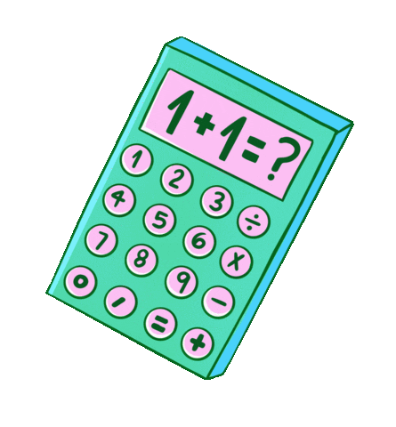
The Duckworth–Lewis system, devised by statisticians Frank Duckworth and Tony Lewis (and lately modified by Steve Stern), was invented in the 1990s as a replacement for alternative rules on what to do if it rained during cricket games. It got its due after the 'unfair' rain rule that cost South Africa a World Cup spot in 1992. The Proteas' task of 22 from 13 balls was reduced after a brief rain to 21 required off a single delivery in a notorious World Cup semi-final against England.
Tony Lewis
Frank Duckworth

Slide 7
History Of DLS.

Slide 8
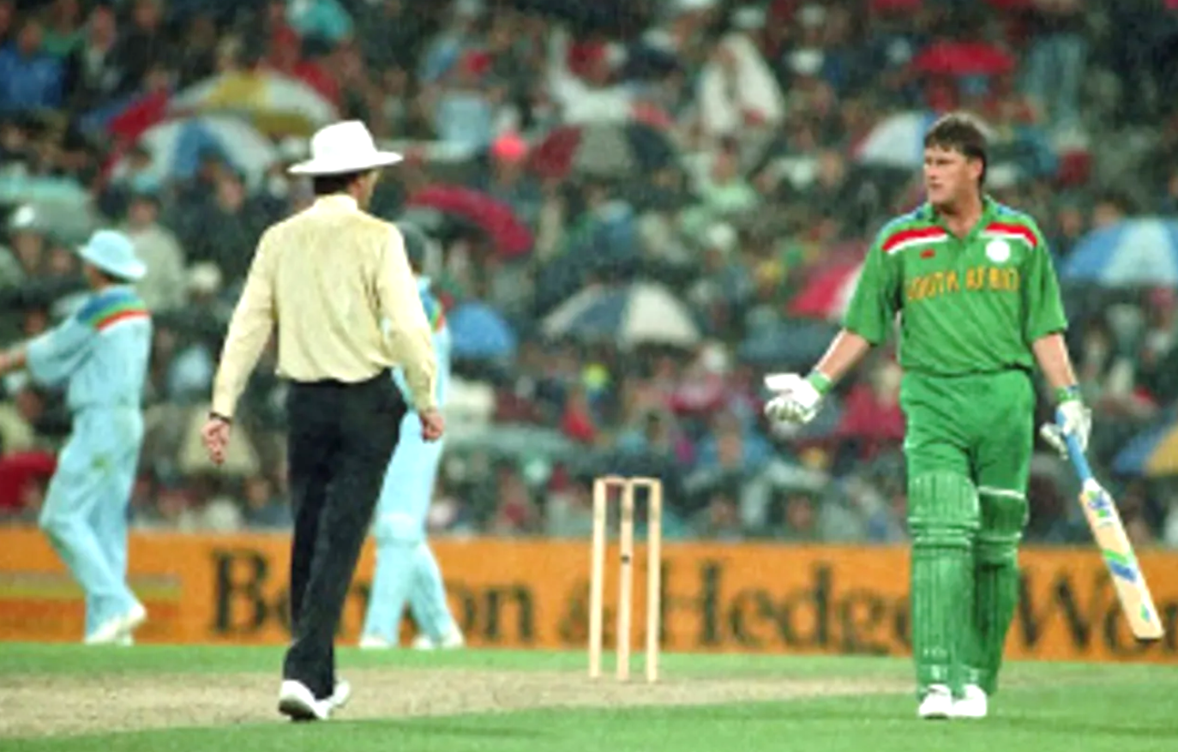
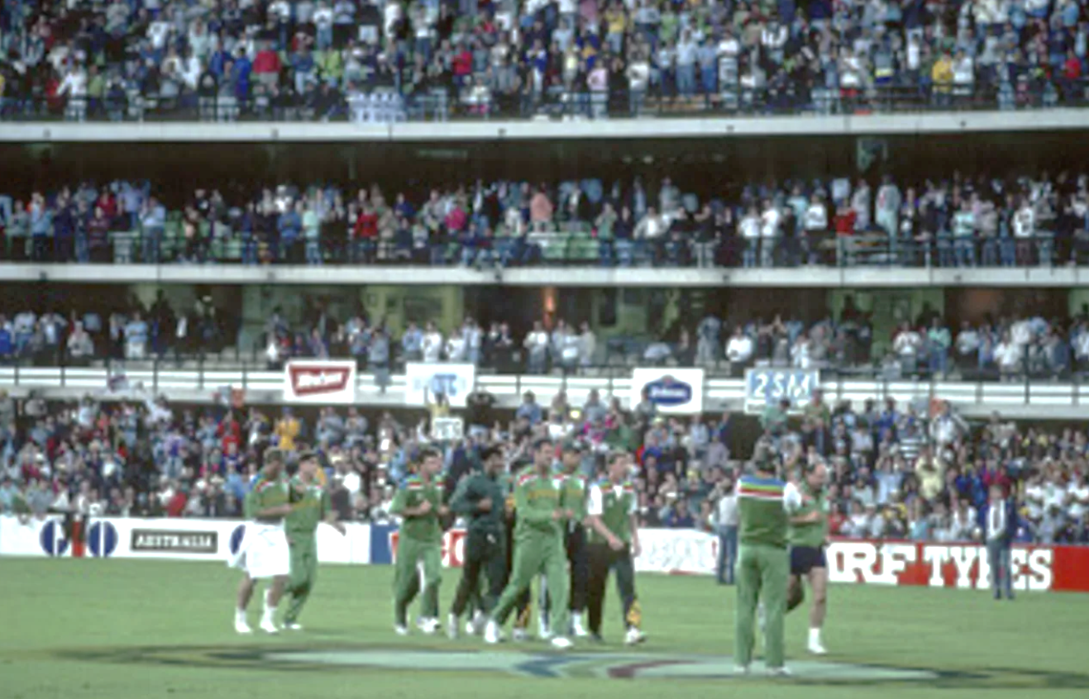
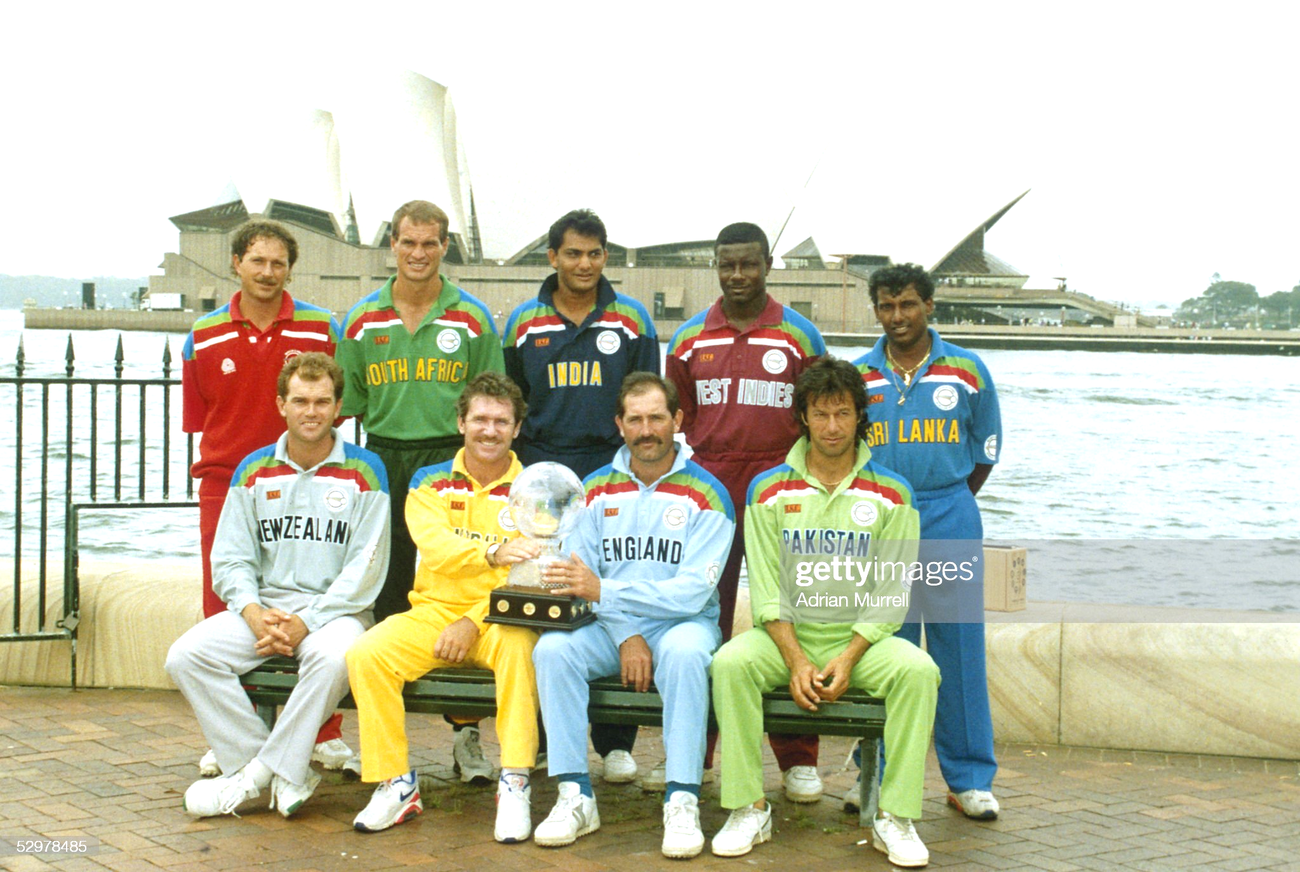

Slide 9
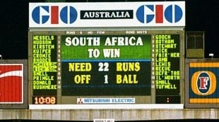
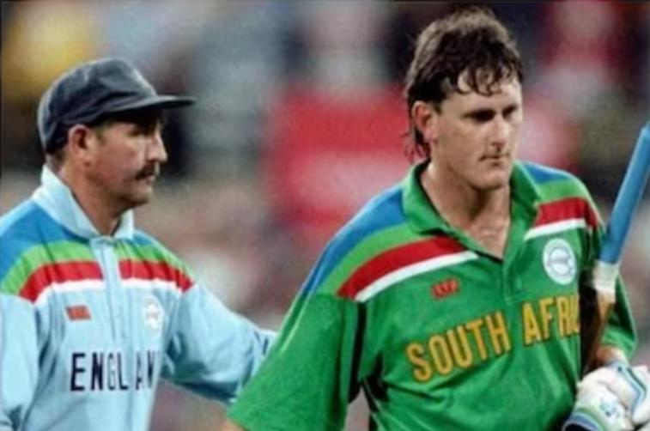
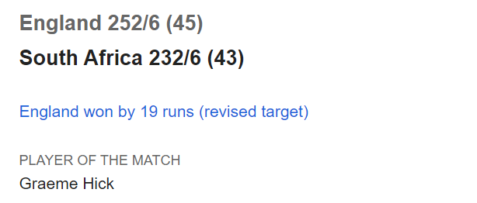
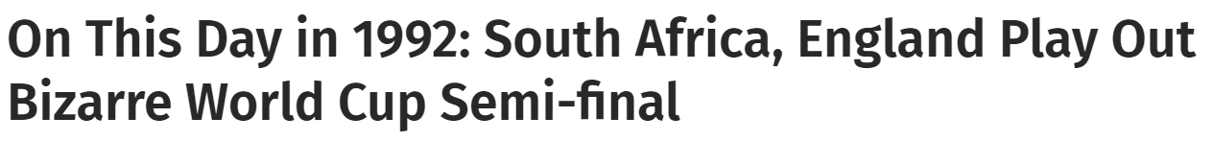

Slide 10

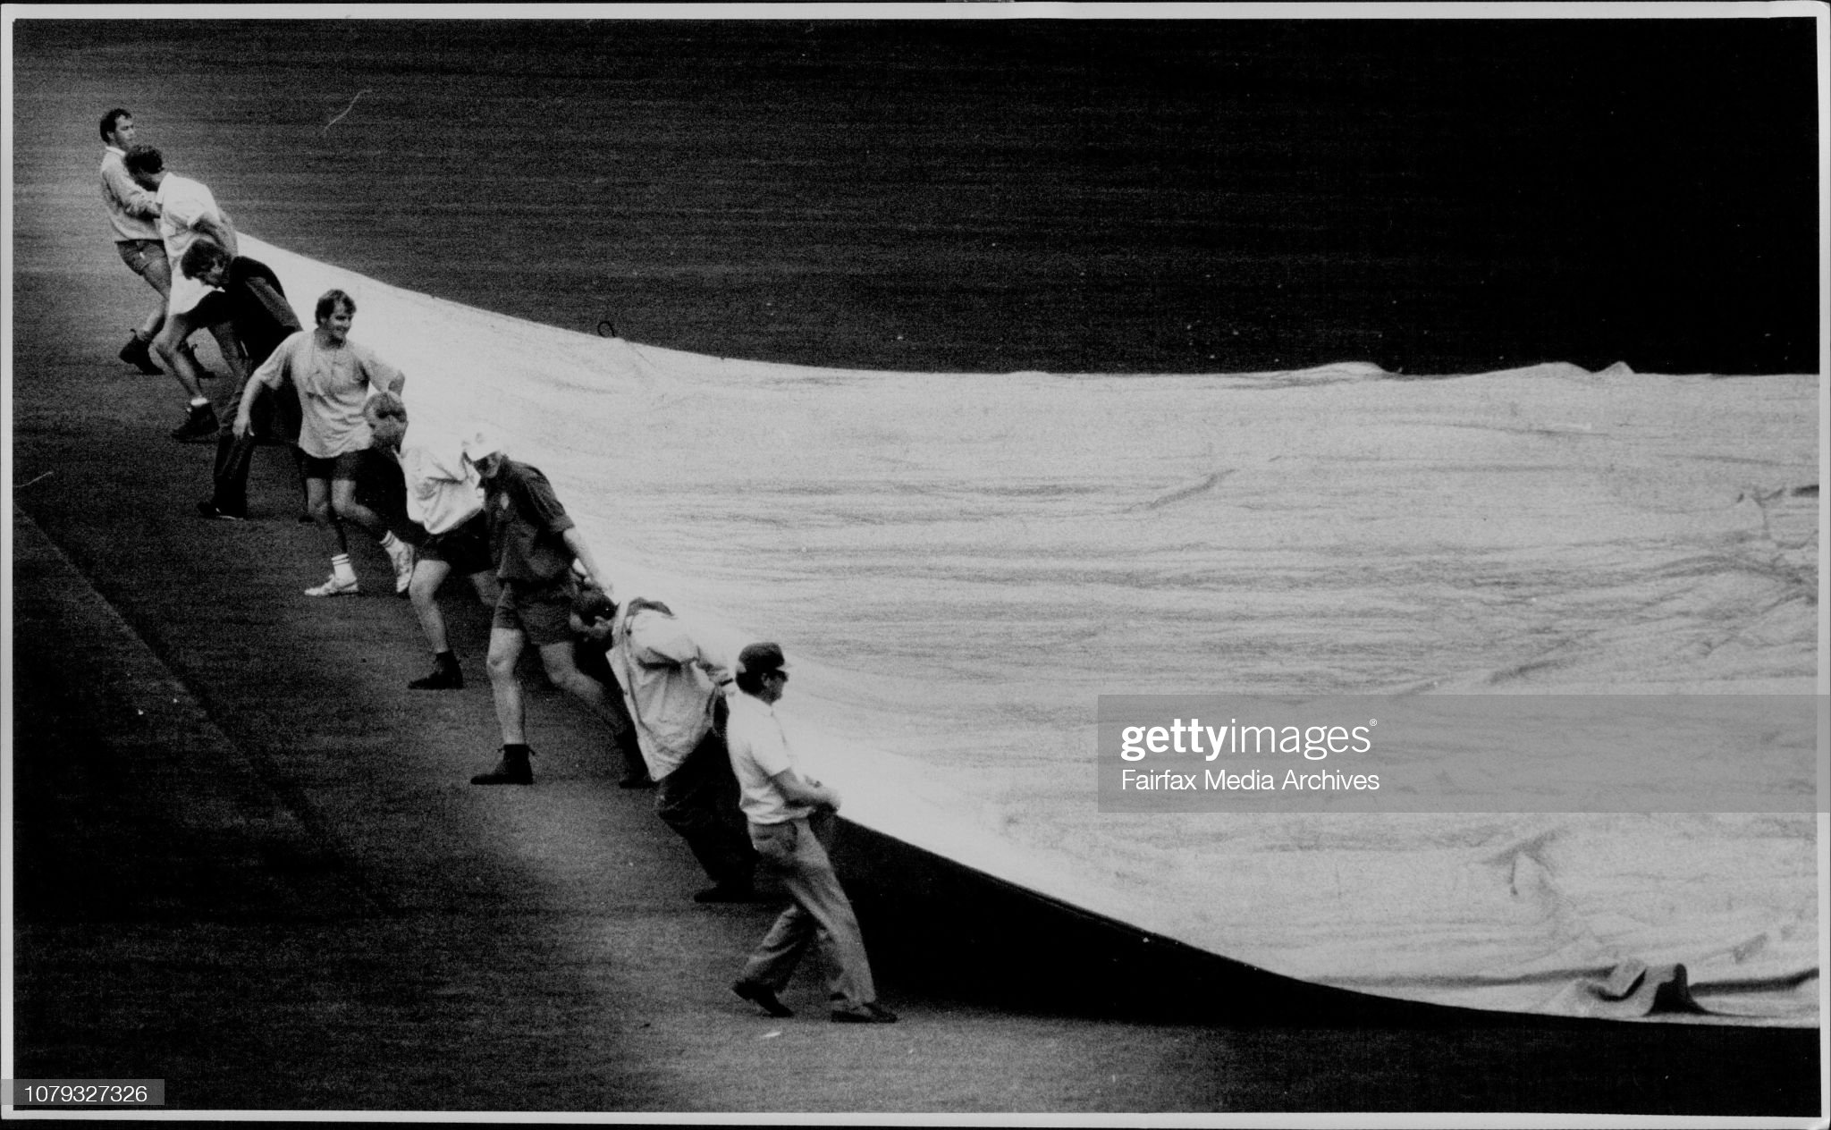
Ground Staff
Covering The
Pitch Of Cricket
Due to Rain
In RSA Vs ENG
1992 CWC
Semi-Final Match
Sydney Australia

Slide 11
WHEN TO USE DLS METHOD ?

Slide 12





DLS method is used in cricket to adjust target scores in limited-overs matches that are interrupted by:
Rain
Thunderstorms
Hails
High Winds
Low light
Any Eclipse
Any Human Caused Disaster

Slide 13
HOW DLS METHOD IS USED ?

Slide 14



$$T_{2}^{pr}=T_{1}^{s}×\left(\frac{T_{2}^{r}}{T_{1}^{r}}\right)$$
$$T_{2}^{pr }$$
= Team 2’s par score.
$$T_{1}^{s}$$
= Team 1’s score of 1st inning.
$$T_{2}^{r}$$
= Team 2’s resource value.
$$T_{1}^{r}$$
= Team 1’s resource value

Slide 15
RESOURCE CHART
To understand the DLS method, it is important to understand the concept of resources in cricket. The resources available to a team in a limited-overs match are the wickets and the overs. The DLS method uses these resources to calculate a fair target score.
 | Wickets lost
Overs left | 0 | 2 | 5 | 7 | 9
60 | 107.1 | 87.9 | 50.0 | 26.5 | 7.6
50 | 100.0 | 83.8 | 49.5 | 26.5 | 7.6
40 | 90.3 | 77.6 | 48.3 | 26.4 | 7.6
30 | 77.1 | 68.2 | 45.7 | 26.2 | 7.6
25 | 68.7 | 61.8 | 43.4 | 25.9 | 7.6
20 | 58.9 | 54.0 | 40.0 | 25.2 | 7.6
10 | 34.1 | 32.5 | 27.5 | 20.6 | 7.5
5 | 18.4 | 17.9 | 16.4 | 14.0 | 7.0

Slide 16

Team 1 have scored 250 runs from their 50 available overs and Team 2 lose 5 wickets in scoring 199 runs in 40 overs. Play is then stopped by the weather, the rain refuses to relent and the match is abandoned. A decision on the winner is required.

Slide 17
Team 1's innings: this was uninterrupted, so the resource percentage available is 100%.
Team 2's innings: resource % available at start of innings = 100%
After 40 overs Team 2 have 10 overs left and have lost 5 wickets.
From table, resource % left at suspension of play = 27.5%
As play is abandoned all this remaining resource is lost.
Hence resource % available for Team 2's innings = 100 - 27.5 = 72.5%
Team 2 had less resource available than Team 1 so their target must be scaled down by the ratio of resources, 72.5/100
Team 1 scored 250, so Team 2's 'target' is 250 x 72.5/100 = 181.25
As there is to be no further play, the winner is decided according to whether or not this target has been exceeded. With 199 runs on the board, they have exceeded their required target by 17.75 and so are declared the winners by 18 runs.

Slide 18
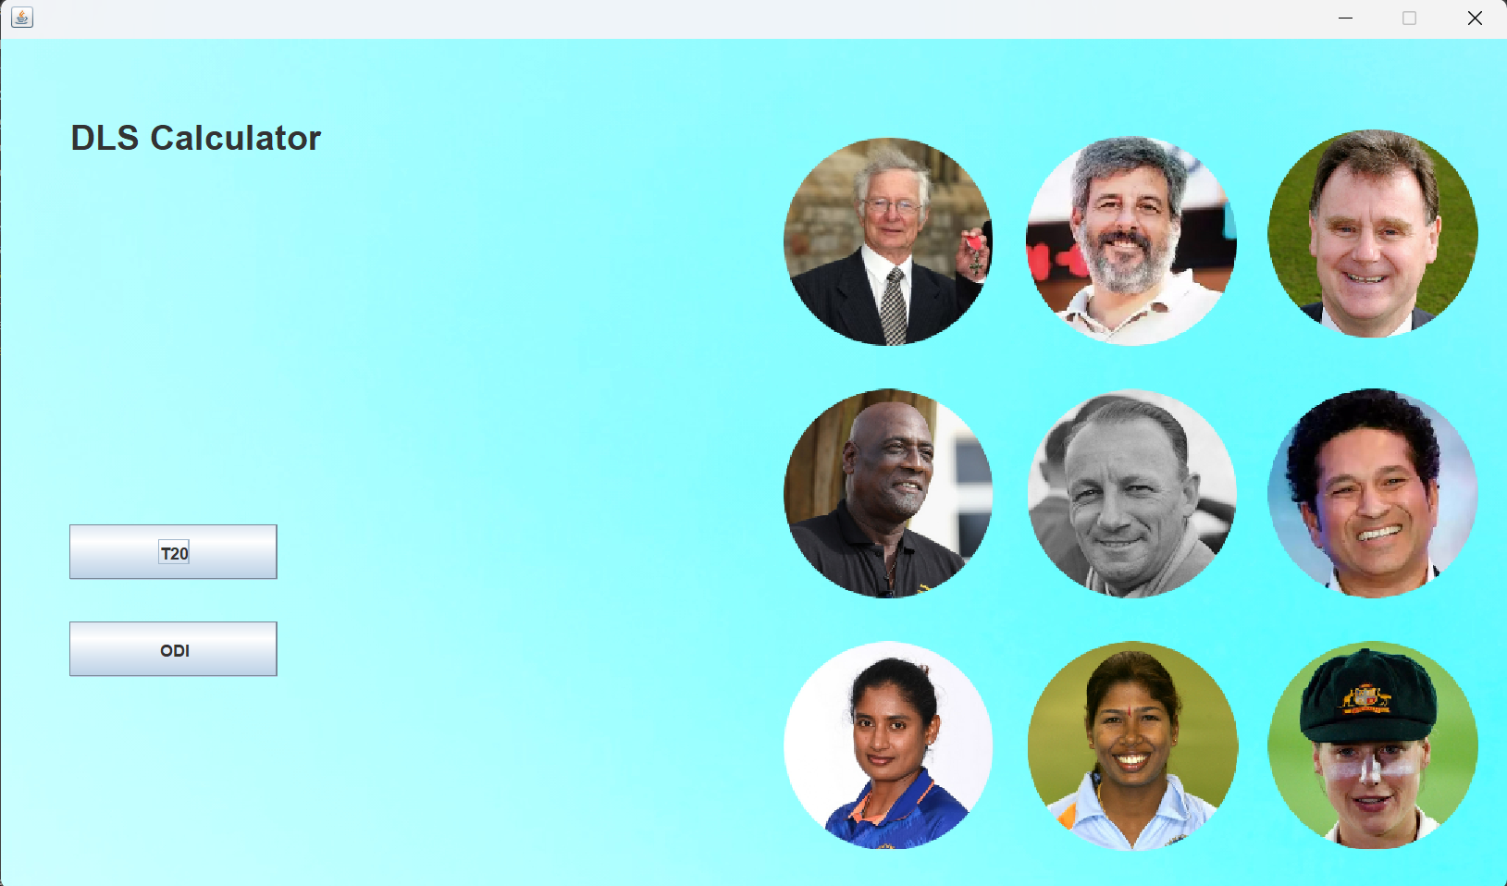

Slide 19
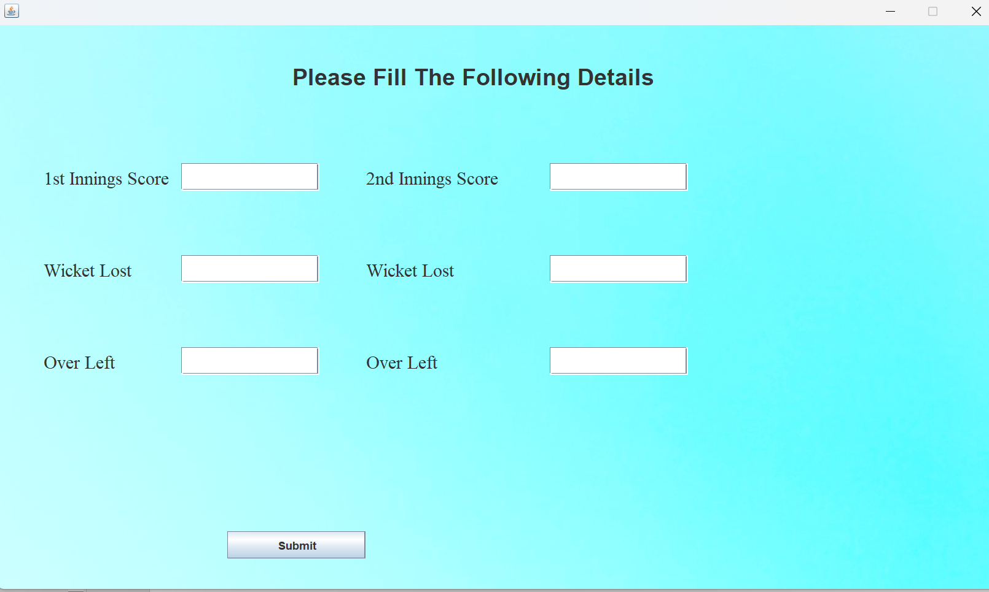

Slide 20
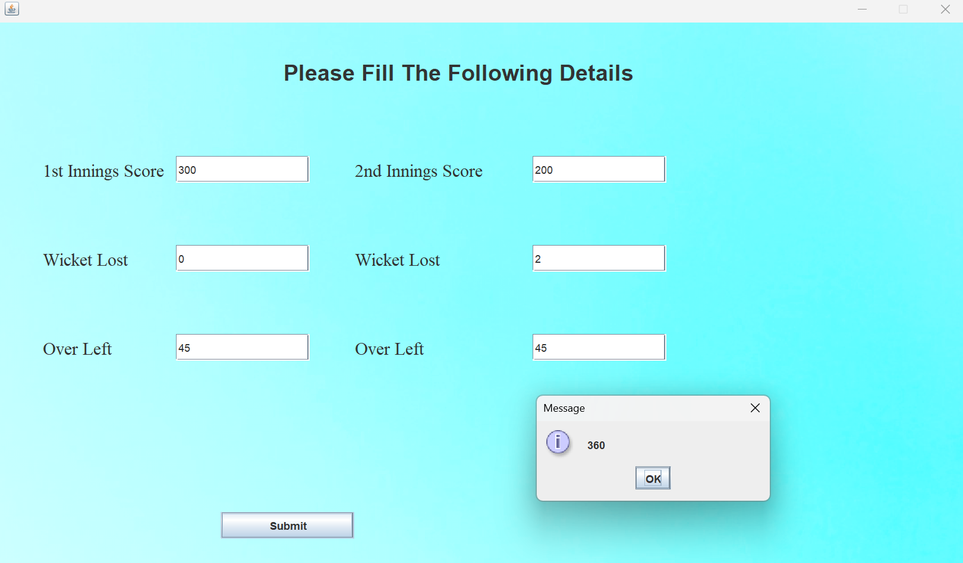

Slide 21
Conclusion

Slide 22
The DLS method is a crucial tool in the world of cricket and helps to ensure that limited-overs matches are fair and competitive. It is widely used by cricket boards, players, and fans to adjust target scores and calculate the winner of a match in the event of a rain interruption.

Slide 23


